Slide 1
Design-
PolyMorpher
CS 410 - Team Silver
Old Dominion University
December 7, 2017

Slide 2
Team Silver Mentor
Professor Thomas Kennedy
Lecturer Professor, Old Dominion University
M.S. in Computer Science, Old Dominion University
Excels at:
Working directly with students
Outlining course information
Conveying an exceptional level of proficiency in the most current Computer Science practices

Slide 3
Team Silver
Joel Stokes
Game Development Specialist
Colten Everitt
Website Administrator
Matthew Tuckson
Program/Project Manager
Peter Riley
Software Engineering Expert
Daniel Dang
Web Development Expert
Casey Batten
Unity SDK Specialist
Nathaniel DeArce
Artificial Intelligence Agent
Tyler Johnson
Software Engineering Expert
Kevin Santos
Database Manager

Slide 4
Table of Contents
Background Information
Key Terms
Problem Statement
Student Progression Dilemma
Current Process Flow
Solution Statement
Target Customers
End Users
Solution Process Flow
Plans for our Solution
Competition Matrix
Competition vs. our Solution
Major Functional Components
Concepts of Gameplay and Possible Design Choices
Structure of PolyMorpher
Software Requirements
Version Control
Agile Development Model
Work Breakdown Structure (WBS)
Work Breakdown Structure - Design
Work Breakdown Structure - Algorithms
Work Breakdown Structure - Deployment
Software Iterations
Software Iterations: Core Algorithm
Software Iterations: API Book Algorithm
Software Iterations: Compiler Algorithm
Software Iterations: Game Testing
Dataflow Algorithms
Core Algorithm Dataflow & Pseudocode
API Book Algorithm Dataflow & Pseudocode
Compiler Algorithm Dataflow & Pseudocode
Risk Matrix & Mitigations
Benefits to Customer
Conclusion
References
Appendix A : User Stories
Appendix B : Student Progression Dilemma Statistics
Appendix C : Rapid Prototype GUI Samples
Appendix D : Unity SDK Information

Slide 5
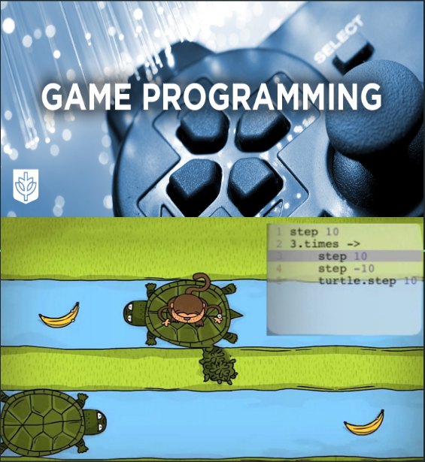
Why a Game?
Enhance interest among new learners
Nature of interaction inherently gives players a more natural way to learn content
Change the learning style from traditional to more dynamic
Does not require an instructor present at all times
Object-Oriented Programming and problem solving can potentially be better grasped and understood
See Appendix D for additional Unity SDK information
Image 1 source : http://www.cdm.depaul.edu/academics/Pages/BS-in-Game-Programming.asx
Image 2 source: Peter Riley’s presentation
Notes:
Image 1source:http://www.cdm.depaul.edu/academics/Pages/BS-in-Game-Programming.asx
Image 2 source:Peter Riley’s presentation
The purpose of this slide is to illustrate our proposal as to why a game is the most solid approach to the previously mentioned societal problem. The five bulleten points describe the following:
•It is generally inferred that games in particular enhance interest in people. Thus, a game that is designed to teach a particular subject can be highly assumed that it gain the learner’s interest.
•In addition, interaction in general allows one to cope with the learning content aspect in natural way that engages interest.
•The traditional learning style has become increasingly primitive with the emerge of new technologies. Thus, a learning game can provide a more dynamic and interactive way of learning and in order to ignore the more traditional way.
•On aspect that makes a game a more asynchronous way of learning is that an instructor is not required to present for the learner to learn. This is one extremely positive aspect in the sense that such game will provide all the learning material available to the user..
•As previously mentioned with regards to the stats on the CS student dilemma progression, it is noted that students struggle with the programming aspect of object oriented and problem solving. Therefore, it is highly and potentially inferred that a game ideally allow the user to grasp, retain, and regurgitate such aspects.

Slide 6
Influences of Games on Learning
Poor academics and knowledge decrement lead to the stigma of video games being detrimental to the learning process. However, research evidence has shown that traditional learning through textbooks contributes to low engagement when compared to interactive media (see Appendix D for additional Unity SDK information).
According to the Office of Naval Research (ONR):
Video games have positive aspects that help people become more engaged in the learning process
On average, 56 - 95% of people who play a particular game to learn a particular subject through tests, demonstrated a better understanding of such subject
Educational games with a solid foundation and interactive components keep the players engaged and promote enhanced concept learning
Stats Source:
The Benefits of Video Games. (2011, December 26). Retrieved October 19, 2017, from http://abcnews.go.com/blogs/technology/2011/12/the-benefits-of-video-games/
Notes:
ONR: Office of Naval Research.
WebMD: Medical Organizational website that conducts research on various
Stats Source:
The Benefits of Video Games. (2011, December 26). Retrieved October 19, 2017, from http://abcnews.go.com/blogs/technology/2011/12/the-benefits-of-video-games/
The purpose of this slide is to inform on the information gathered regarding some research statistics by various organizations on the postive aspects of using games as a learning tool.
•The first bulletin briefly explains that the mentioned three organizations investigated and determine that video games provided various positive aspects that help individuals become more engaged in the learning process.
•The second bullet points points out specific numeric statistics on the average percent of individual that played games showed an improvement on the understanding on the particular material the game was teaching.
•The third bulletin concludes that the investigation conducted by this study supports the idea that games can be versatile in the aspect of getting users engaged in the learning process.

Slide 7
Key Terms
Non-Technical User - User who lacks formal education/knowledge in computer science, computer programming, object-oriented programming, or problem solving
Non-Technical Game - User-Friendly gameplay able to be utilized by non-technical users
User-Friendly - Easy to comprehend by non-technical users

Slide 8
PolyMorpher
Programming is intimidating for the uninitiated. As a result, first time ODU programming students drop out or switch majors. Existing tools fail to teach Object-Oriented Programming (OOP) concepts and problem solving skills.
Our Problem Statement

Slide 9
Student Progression Dilemma for CS Students at ODU
CS Courses as Requirements (See Appendix B for Additional Statistics)
CS150:
“Service Course”
Required to be taken by CS, Physics, Math, Engineering, & Mod-Simulation majors
CS250:
Required to be taken by CS, Mod-Simulation, & Computer and Electrical Engineering majors
CS330:
Required to be taken by CS & Mod-Simulation majors
CS361:
Required to be taken by CS & Computer and Electrical Engineering majors
CS350:
Required to be taken by CS & Computer Engineering majors

Slide 10
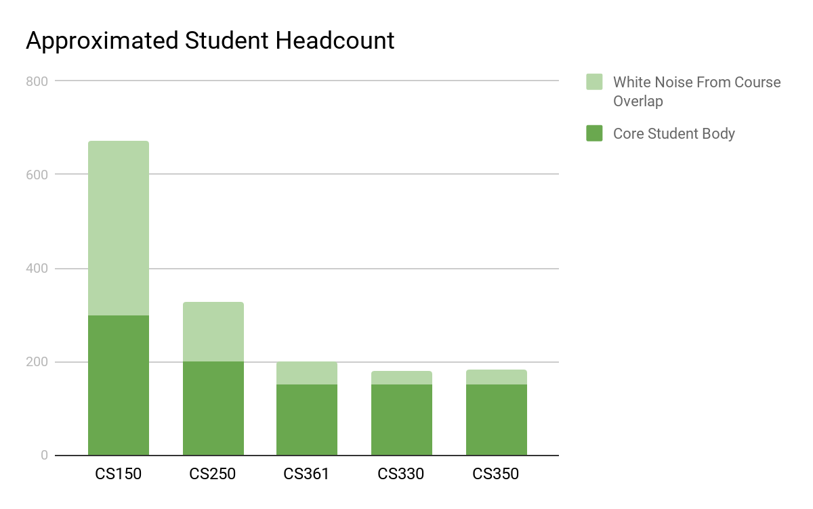
Student Progression Dilemma - Table & Graph
 | CS 150 | CS 250 | CS 361 | CS 330 | CS 350
2013-2014 | 804 | 327 | 161 | 111 | 93
2014-2015 | 672 | 367 | 208 | 203 | 148
2015-2016 | 937 | 327 | 217 | 195 | 183
2016-2017 | 920 | 337 | 199 | 180 | 182
2014 - 2017

Slide 11
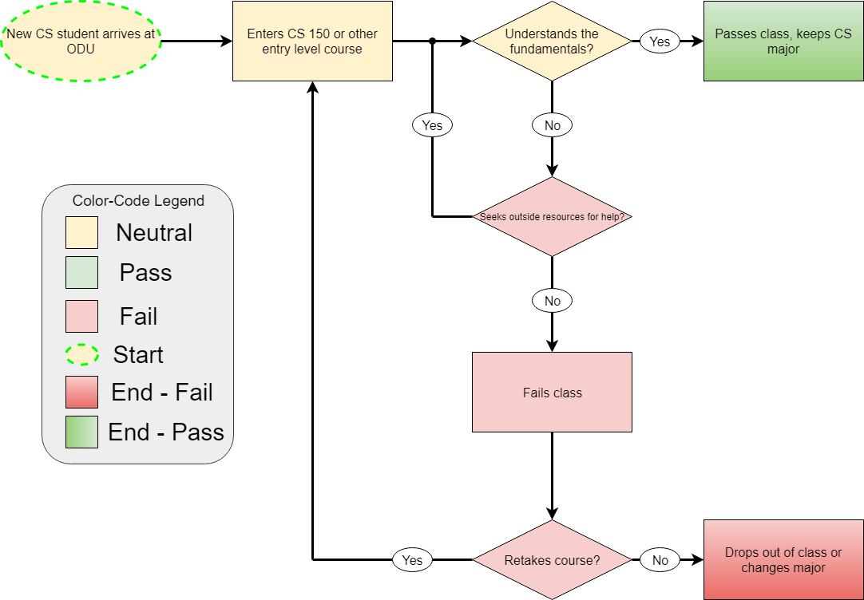
Current Process Flow

Slide 12
PolyMorpher
PolyMorpher will address Object-Oriented Programming (OOP) concepts and problem solving through the use of a management simulator and a Tangible User Interface (TUI).
Our Solution Statement

Slide 13
Target Customers
Initial focus will be Old Dominion University, as well as other universities, colleges, and educational institutions that currently offer a Computer Science degree program
Anyone could use this product in order to gain more knowledge in computer programming, Object-Oriented Programming concepts, and problem solving skills
Image Source : http://odu.edu/compsci

Slide 14
End Users
Students who are currently enrolled in a Computer Science degree program at Old Dominion University, or at other universities, colleges, or educational institutions
Left image source: https://online.odu.edu/programs/computer-science-ms
Middle image source: https://online.odu.edu/programs/computer-science
Right image: https://online.odu.edu/programs/computer-science-minor
Notes:
Image Source:
Left image https://online.odu.edu/programs/computer-science-ms
Middle image: https://online.odu.edu/programs/computer-science
Right image: Pending

Slide 15
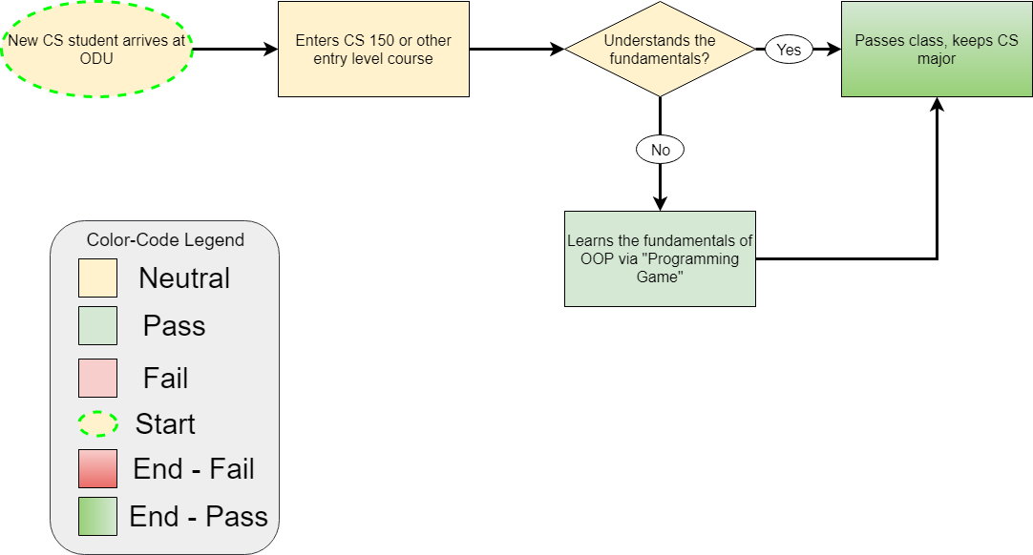
Solution Process Flow

Slide 16
Plans for our Solution
Solution: Game application that teaches users the fundamentals of computer programming and software development
This application will:
Teach Object-Oriented Programming (OOP) concepts
Teach problem solving skills
Strive to teach multiple languages
Be developed for multiple platforms
Be a single player game
Be a standalone downloadable .exe application (no WiFi or Internet connection required)

Slide 17
Competition Matrix Part 1
Game | Experience | Uses OOP | Teaches OOP | # Languages | Multiplayer
PolyMorpher | Low-Mid | Yes | Yes | 1 | No
Code Combat | Low | Yes | No | 5 | No
Screeps | Mid-High | Yes | No | 1 | Yes
CheckIO | Low-High | Yes | No | 1 | Yes
Code Monkey | Low | No | No | 1 | No
Elevator Saga | Mid-High | Yes | No | 1 | No
Codewars | Mid-High | Yes | Yes | 6 | Yes
Codingame | Low-High | Yes | No | 25+ | Yes

Slide 18
Competition Matrix Part 2
Game | Experience | Uses OOP | Teaches OOP | # Languages | Multiplayer
PolyMorpher | Low-Mid | Yes | Yes | 1 | No
Git Games | Low | No | No | 1 | No
CSS Diner | Low | No | No | 1 | No
Flexbox Defense | Low-Mid | No | No | 1 | No
Ruby Warrior | Low | No | No | 1 | No
Untrusted | Mid-High | No | No | 1 | No
Empire of Code | Low-Mid | Yes | No | 2 | Yes
Ruby Quiz | Mid-High | Yes | No | 1 | No

Slide 19
Competition vs. Our Solution
Competition Trends:
Low programming experience
Focus on one or two languages
Mainly teaches syntax, rather than OOP
Some include multiplayer
Our Solution:
Low programming experience
Start with one or two languages, but allow for teaching more in the future
Focus on OOP concepts, with syntax being a secondary objective
Multiplayer will depend on what gameplay features are implemented

Slide 20
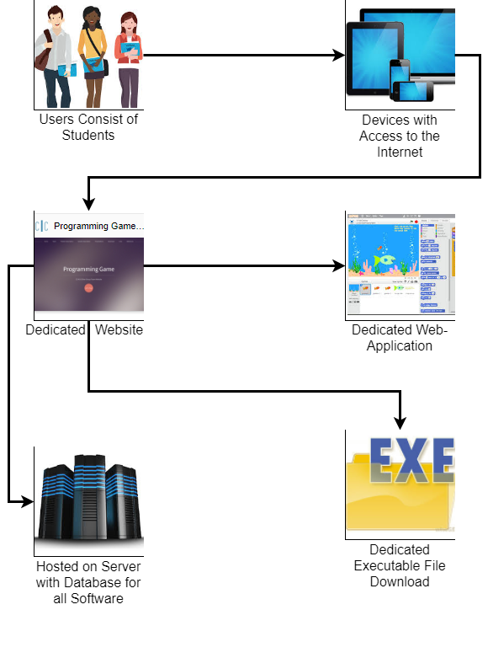
Major Functional Components
Users connect to the Internet using their preferred device
Our game will teach users Object-Oriented Programming concepts as well as problem solving skills

Slide 21
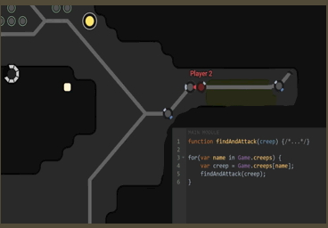
Concepts of Gameplay and Possible Design Choices
Realistic Approach:
Using relatable and applicable examples
Improvement on Teaching:
More complex Object-Oriented Programming concepts that can be easily explained
Balance Gameplay and Programming:
Implementation of the gameplay will not sacrifice the player's experience
Image source 1: https://medium.com/@techloop.io/funniest-programming-memes-1da50c5229d
Notes:
Image source 1: https://medium.com/@techloop.io/funniest-programming-memes-1da50c5229d
This slide illustrated the possible potential design choices of the game designed to teach users how to program.
•First bulletin explains that the game will enhance a relatable and applicable design to provide a more realistic approach.
•The second bulletin explains and contents that a realistic approach promotes a learning improvement mainly on teaching OOP concepts.
•Third bulletin contents that a balance of gameplay and programming at the same time will engage the player more pragmatically rather than sacrifice their experience.

Slide 22
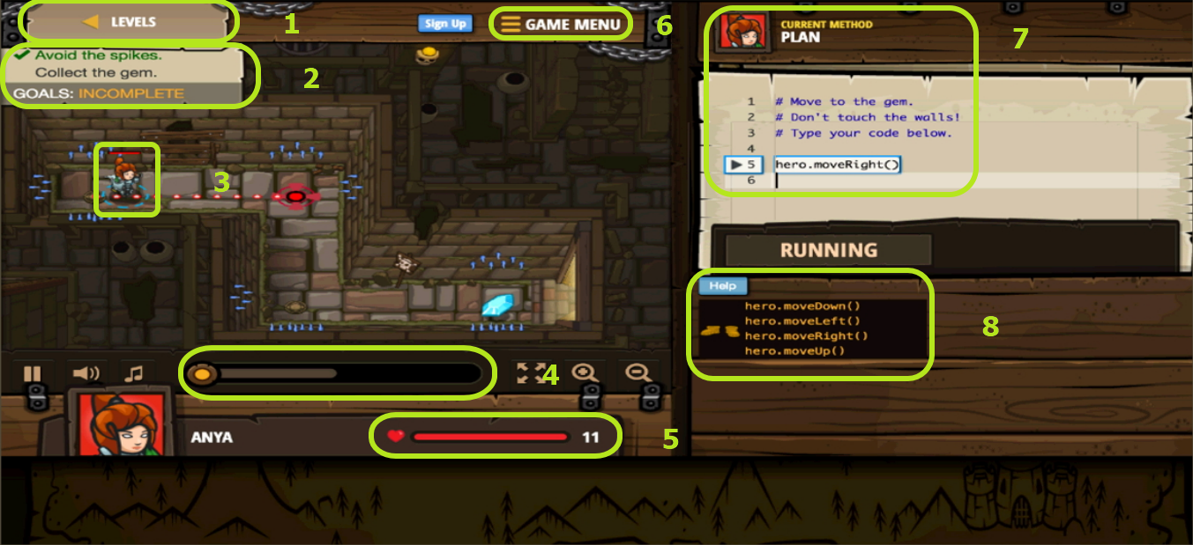
Structure of PolyMorpher
Level Structure
Objectives / Goals
Single Player
Sound Bar
Health Bar
Game Menu
Current Method Plan
Help Menu
Notes:
Still need to make boxes and numbers all neat and uniform

Slide 23
Software Requirements
For Development:
C# Programming Language
Unity SDK
Third-Party Libraries & APIs
Mono
Microsoft C# CodeCompiler
Gitlab
SourceTree (Development Source Control)
For Production:
Unity SDK
Windows 7, 8, 8.1, 10
Linux (Any Version)
MacOS (Any Version)

Slide 24
Version Control Components
Unity:
Game engine where source code is edited
SourceTree:
Free git client for Windows and Mac
Uses PuTTY
PuTTY:
Pageant client interfaces with GitLab
Continuously runs in the background
GitLab:
Online git repository manager
Notes:
Image source: https://commons.wikimedia.org/wiki/File:Unity_Technologies_logo.svg
https://www.google.com/search?q=sourcetree+logo&rlz=1C1CHFX_enUS602US603&source=lnms&tbm=isch&sa=X&ved=0ahUKEwinpJLA48PXAhUI04MKHatGD2sQ_AUICigB&biw=1524&bih=734#imgrc=9XEG3IpGamQSjM:
https://www.google.com/search?rlz=1C1CHFX_enUS602US603&biw=1524&bih=734&tbm=isch&sa=1&ei=EOANWoHJKoKKmQH_kZC4AQ&q=putty+logo&oq=putty+logo&gs_l=psy-ab.3..0j0i5i30k1l4j0i10i24k1l2.20144.20845.0.21235.5.5.0.0.0.0.186.456.0j3.3.0....0...1.1.64.psy-ab..2.3.456...0i67k1j0i7i30k1j0i7i5i30k1.0.QBValcHmiP0#imgrc=7AOMGVHctEOEhM:
https://www.google.com/search?q=gitlab+logo&rlz=1C1CHFX_enUS602US603&source=lnms&tbm=isch&sa=X&ved=0ahUKEwiki5fb48PXAhUp4YMKHVvIDfMQ_AUICigB&biw=1524&bih=734#imgrc=WoFU5ZrxYlj3zM:

Slide 25
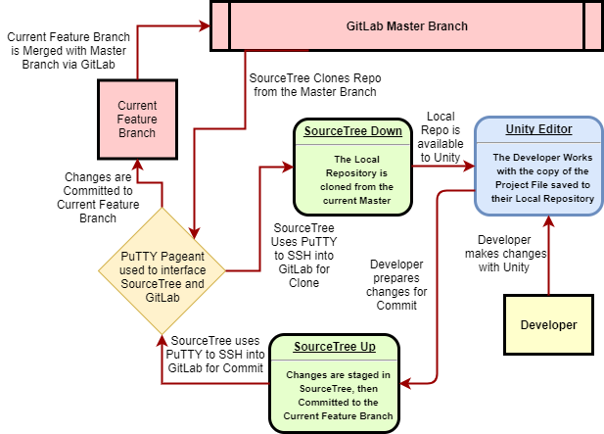
Version Control
Flow Diagram

Slide 26
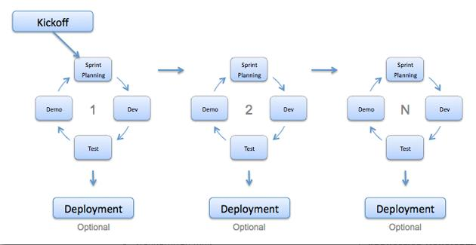
Agile Development Model

Slide 27
Work Breakdown Structure (WBS)

Slide 28
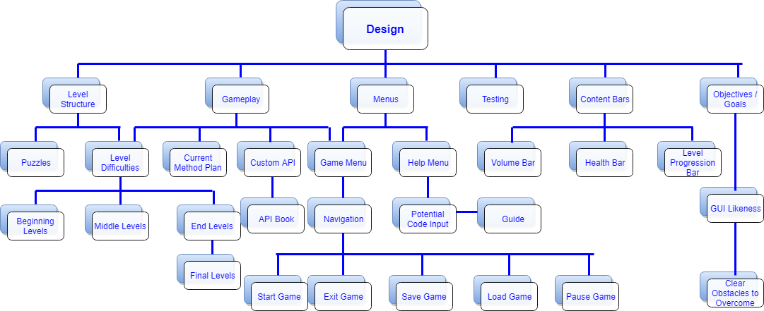
Work Breakdown Structure - Design

Slide 29
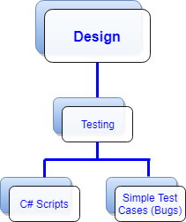
Work Breakdown Structure - Design (Testing)

Slide 30
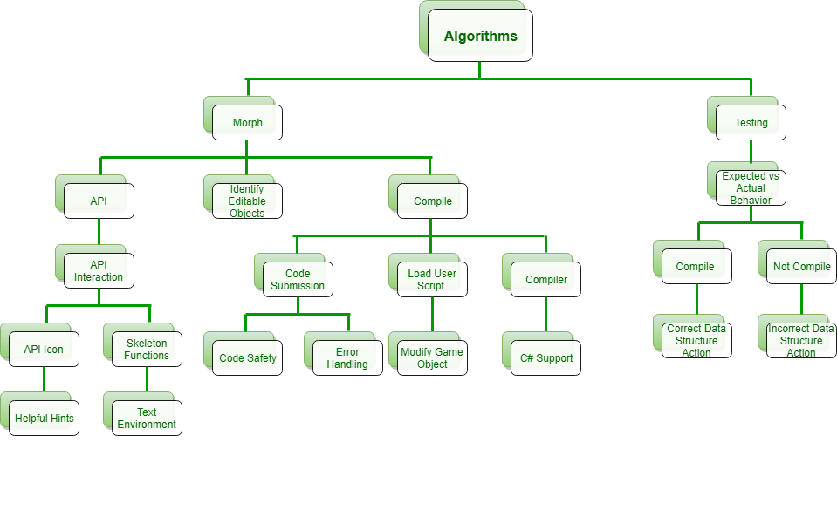
Work Breakdown Structure - Algorithms

Slide 31
Work Breakdown Structure - Deployment

Slide 32
Software Iterations
Core Algorithm
API Book Algorithm
Compiler Algorithm
Game Testing

Slide 33
Software Iterations: Core Algorithm
Core Algorithm
UI level algorithm
Determines the base tools at the player’s disposal
Divides gameplay into distinct sections of:
Interaction through UI elements/Object selection
Information Provision through access to the API Book Algorithm
Alteration through the Compiler Algorithm
API Book Algorithm
Compiler Algorithm
Game Testing

Slide 34
Software Iterations: API Book Algorithm
Core Algorithm
Acts as primary method of information distribution from game designer to player
Interacts directly with Compiler Algorithm by determining the knowledge base the player has to exploit in the Compiler Algorithm
Directly influences the outcome of gameplay/challenges by offering the player a multitude of tools to interact with their environment
API Book Algorithm
Compiler Algorithm
Game Testing

Slide 35
Software Iterations: Compiler Algorithm
Core Algorithm
Controls and continuously affects the Back-End of the game itself
Directly determines the behavior of objects in the game’s environments at a fundamental level
Responsible for the amount of control and open design power the player is granted during gameplay
Co-dependant on the API Book Algorithm based on the tools the player is likely to find there to use within the Compiler Algorithms in-game dependencies
API Book Algorithm
Compiler Algorithm
Game Testing

Slide 36
Software Iterations: Game Testing
Core Algorithm
Aspects to test:
API Book in-game application
Compiling of user-input source code
Effectiveness of TUI and gameplay
API Book Algorithm
Alpha Test
Beta Test
Compiler Algorithm
Closed testing conducted by Team Silver
The API Book will be the focus
Open testing conducted by ODU faculty
The Compiling, TUI, and Gameplay will be the focus
Game Testing

Slide 37
Dataflow Algorithms

Slide 38
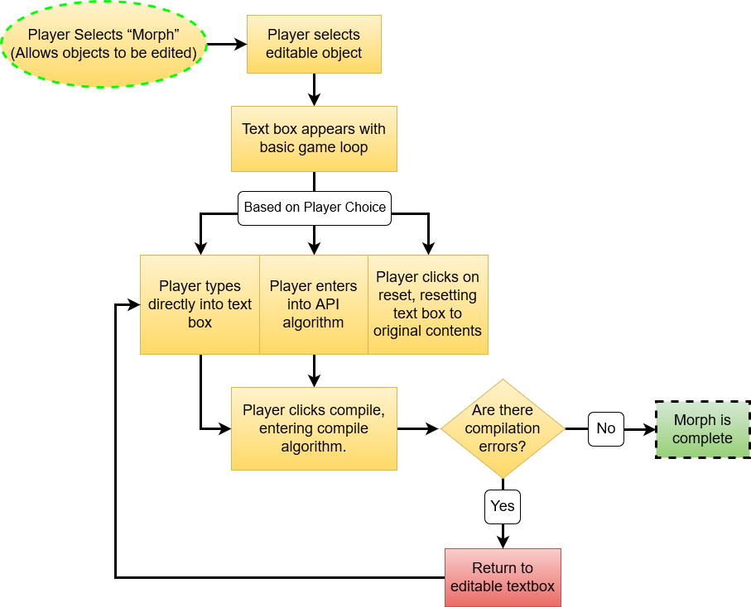
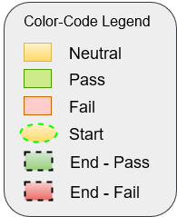
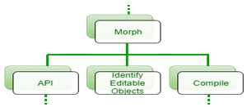
Core Algorithm

Slide 39
Core Algorithm: Pseudocode
Core Algorithm{
if (Button Clicked = MORPH Button){
Selectable System{
if (Object in Level is marked as Editable){
Make Objects Selectable
}
}
if (Object is Selected){
Make Objects no longer Selectable
Create Instance Of(Code Editing Interface)
Pass Selected Object Name onto Compiler Algorithm
}
}
if (Button Clicked = API Button){
Create Instance Of(API Book User Interface)
}
}

Slide 40
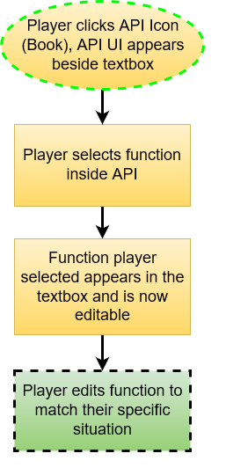
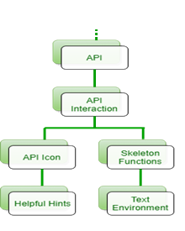
API Book Algorithm

Slide 41
API Book Algorithm: Pseudocode
API Book Algorithm{
Pull predetermined list of "functions" and "tools" for the player to learn this Level
Fill Book{
Proliferate "Pages" of the API Book with individual tool info
Fill Text Box at bottom of Page with example code
if (Button Clicked = Use This Code Button){
if (Code Editing Interface is Open){
Copy example Code to Code Editing Interface
}
}
}
}

Slide 42
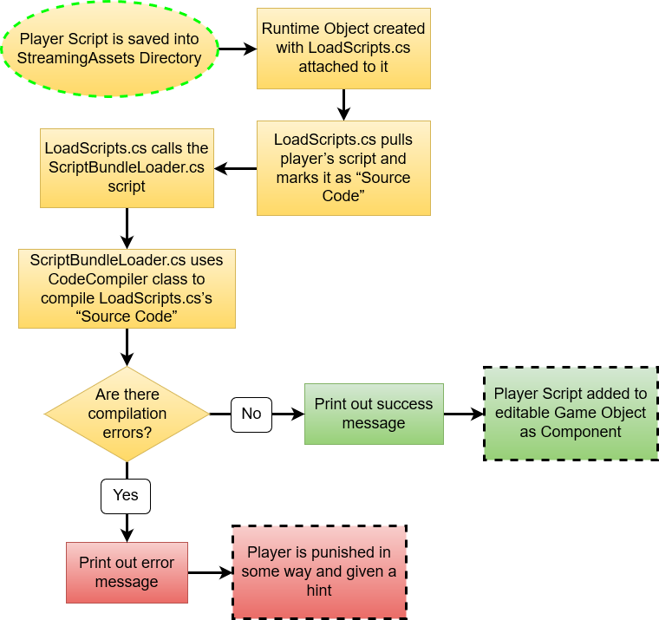
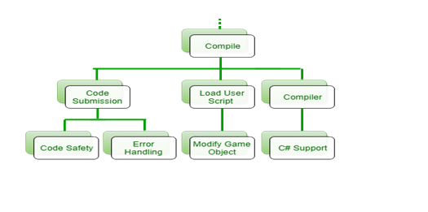
Compiler Algorithm

Slide 43
Compiler Algorithm: Pseudocode
Compiler Algorithm{
Take name of Selected Object from Core Algorithm
Load related Script from "StreamingAssets" folder into the Code Editing Interface
if (Button Clicked = Close){
Close the Code Editing Interface
}
if (Button Clicked = Reset){
Revert Current Script back to template version
}
if (Button Clicked = Compile){
Save new code to Script's source file
Run a Sandboxed Compilation of that file in real time
if (Compilation FAILS){
Create Text: ERROR Message containing Compilation Error line/type
Create Instance Of(Window with ERROR Message)
}
else (Compilation PASSES){
Create Instance Of(Window with SUCCESS Message)
Attach edited and compiled Script to Selected Object
Re-render level elements in real-time to calculate new object behavior
}
}
}

Slide 44
Risk Matrix Risk Description
Probability
 | Very Low [1] | Low [2] | Medium [3] | High [4] | Very High [5]
Very High [5] |  |  | T1, T4
High [4] |  | T3, C2 |  | C3
Medium [3] |  | T2
Low [2] |  |  | C1
Very Low [1]
Customer Risks
C1. User Gets Lost
C2. Dissatisfied User
C3. Insufficient Content / Time
Technical Risks
T1. User Implements Bad Code
T2. Insufficient Hardware
T3. Critical Software Bugs
T4. Insufficient API Support
Impact

Slide 45
C1 : User Gets Lost
C1: User gets stuck and does not know what to do - low level of technical experience
Medium Probability - Low Impact
Mitigation: Include enough resources and hints that the user can effectively learn the material
 | Very Low [1] | Low [2] | Medium [3] | High [4] | Very High [5]
Very High [5] |  |  | T1, T4
High [4] |  | T3, C2 |  | C3
Medium [3] |  | T2
Low [2] |  |  | C1
Very Low [1]

Slide 46
C2 : Dissatisfied User
C2: User dislikes the user interface(UI/UX)
Low Probability - High Impact
Mitigation: The UI/UX design will enhance an approachable interface, various menu options, and an interface that will include clear objects throughout each level
 | Very Low [1] | Low [2] | Medium [3] | High [4] | Very High [5]
Very High [5] |  |  | T1, T4
High [4] |  | T3, C2 |  | C3
Medium [3] |  | T2
Low [2] |  |  | C1
Very Low [1]

Slide 47
C3 : Insufficient Content / Time
C3: Not enough content / time in order to successfully pass introductory CS classes
High Probability - High Impact
Mitigation: Use play testing to optimize the pacing and content of the game
 | Very Low [1] | Low [2] | Medium [3] | High [4] | Very High [5]
Very High [5] |  |  | T1, T4
High [4] |  | T3, C2 |  | C3
Medium [3] |  | T2
Low [2] |  |  | C1
Very Low [1]

Slide 48
T1 : User Implements Bad Code
T1: User implements bad code that crashes the game either because of their own error or because of a malicious post on a forum
Medium Probability - Very High Impact
Mitigation: Under Evaluation - Identified a few potential solutions, but looking for one central solution
 | Very Low [1] | Low [2] | Medium [3] | High [4] | Very High [5]
Very High [5] |  |  | T1, T4
High [4] |  | T3, C2 |  | C3
Medium [3] |  | T2
Low [2] |  |  | C1
Very Low [1]

Slide 49
T2 : Insufficient Hardware
T2: User does not have sufficient hardware to run the game
Low Probability - Medium Impact
Mitigation: Implement a 2D game style that will have minimal draw on a computer’s resources
Game will be optimized 4th gen i3 Intel Processor
 | Very Low [1] | Low [2] | Medium [3] | High [4] | Very High [5]
Very High [5] |  |  | T1, T4
High [4] |  | T3, C2 |  | C3
Medium [3] |  | T2
Low [2] |  |  | C1
Very Low [1]

Slide 50
T3 : Critical Software Bugs
T3: Possible critical software bugs in the game
Low Probability - High Impact
Mitigation: Continuously test software through gameplay and ensure that all possible interactions work well
 | Very Low [1] | Low [2] | Medium [3] | High [4] | Very High [5]
Very High [5] |  |  | T1, T4
High [4] |  | T3, C2 |  | C3
Medium [3] |  | T2
Low [2] |  |  | C1
Very Low [1]

Slide 51
T4 : Insufficient API Support
T4: Insufficient API support for Game help / aid
Medium Probability - Very High Impact
Mitigation: The built in API will have all the necessary tools to help the user refer the specific code syntax and OOP concepts they need to learn to get through the levels of the game
 | Very Low [1] | Low [2] | Medium [3] | High [4] | Very High [5]
Very High [5] |  |  | T1, T4
High [4] |  | T3, C2 |  | C3
Medium [3] |  | T2
Low [2] |  |  | C1
Very Low [1]

Slide 52
Benefits to Customer
Supplies customer with a supplemental programming resource
Naturally learns Object Oriented Design practices and the benefits of employing them
In the case of the initially targeted student demographic, advantages not only in knowledge of potential course material but substantially better odds of success in said course
A genuinely Interactive and Enjoyable experience

Slide 53
Conclusion
PolyMorpher
CS students not introduced to OOP or problem solving skills early on
Skills are essential to build a solid foundation for understanding CS, including programming
Web-application or executable downloadable game using the Unity SDK with C# and JavaScript
User learns Object-Oriented Programming (OOP) concepts and problem solving skills in depth
Skills allow end user to become more proficient in Computer Science, as well as Object Oriented Design

Slide 54
Our Solution Makes the Process Painless & Fun

Slide 55
References
“Fast Facts.” Unity, Unity Technologies, unity3d.com/public-relations.
Asset Store, Unity Technologies, www.assetstore.unity3d.com/en/.
Technologies, Unity. “Welcome to the Unity Scripting Reference!” Unity - Scripting API: Unity Technologies, docs.unity3d.com/530/Documentation/ScriptReference/index.html.
O'Neill, M. (n.d.). Computer Science Before College. Retrieved October 05, 2017, from https://www.computerscienceonline.org/cs-programs-before-college/
Peter Riley’s presentation. It will be one of the main source of references for our project.
“kennedyData.” Thomas Kennedy, https://drive.google.com/drive/u/1/folders/0B_xCQd8Vk2BnSU1hNnJwSXB1NEE
“The Benefits of Video Games.” abcnews (2011, December 26). Retrieved October 19, 2017, from http://abcnews.go.com/blogs/technology/2011/12/the-benefits-of-video-games/ Good Morning America
CS410 Programming Game Pitch, By: Joel Stokes - https://youtu.be/QBvgzFgZaOQ
CS410 Project Dungeon Demo, By: Casey Batten - https://www.youtube.com/watch?v=ynhdd1IKgps
CS410 Dungeon Escape Demo (Short Ver.), By: Casey Batten - https://www.youtube.com/watch?v=VnHRaWl8Y8w

Slide 56
References
CS410 Tech Demo 2, By: Casey Batten - Download Source Code - http://www.cs.odu.edu/~410silver/demos.html
“12 Free Games to Learn Programming.” Mybridge, https://medium.mybridge.co/12-free-resources-learn-to-code-while-playing-games-f7333043de11
currentProcessFlow.html, https://www.draw.io/?state=%7B%22ids%22:%5B%220B3Bc95zBWXg9TFZ6X0FMU1NTdEk%22%5D,%22action%22:%22open%22,%22userId%22:%22108692003133590583047%22%7D#G0B3Bc95zBWXg9TFZ6X0FMU1NTdEk
ProcessFlowDiagram_silver.html, https://www.draw.io/?state=%7B%22ids%22:%5B%220B_xBnZ1ge4PlZTVjV3h6Y2pGSWc%22%5D,%22action%22:%22open%22,%22userId%22:%22108692003133590583047%22%7D#G0B_xBnZ1ge4PlZTVjV3h6Y2pGSWc
Current Process Flow, https://www.draw.io/?state=%7B%22ids%22:%5B%220B-5KdQEdqLUPdnBFUnp2V05uMEE%22%5D,%22action%22:%22open%22,%22userId%22:%22108692003133590583047%22%7D#G0B-5KdQEdqLUPdnBFUnp2V05uMEE

Slide 57
References
Practical Rules for Using Color in Charts, http://www.perceptualedge.com/articles/visual_business_intelligence/rules_for_using_color.pdf
Standard Flowchart Symbols and Their Usage, https://www.edrawsoft.com/flowchart-symbols.php
Work Breakdown Structure (WBS), https://www.draw.io/?state=%7B%22ids%22:%5B%220B-5KdQEdqLUPWnNoSHhIUGg2OTQ%22%5D,%22action%22:%22open%22,%22userId%22:%22108692003133590583047%22%7D#G0B-5KdQEdqLUPWnNoSHhIUGg2OTQ
VersionControlFlow.html, https://www.draw.io/?state=%7B%22ids%22:%5B%221IQj6SYJqC6YLAK_qMRVIQkHiUmr9laBu%22%5D,%22action%22:%22open%22,%22userId%22:%22108692003133590583047%22%7D#G1IQj6SYJqC6YLAK_qMRVIQkHiUmr9laBu

Slide 58
Appendix A : User Stories - Roles Defined
Student: A person playing our game with the goal of learning more about OOP
Player: A person playing our game with the goal of having an enjoyable game experience
*Student and Player may be the same person in many cases wanting to both learn and enjoy the game

Slide 59
Appendix A : User Stories - Student
As a student, I would like to be taught inheritance.
As a student, I would like to be taught abstraction.
As a student, I would like to be taught encapsulation.
As a student, I would like to be taught polymorphism.
As a student, I would like to be taught functional design patterns.
As a student, I would like to be taught how to use an API.
As a student, I would like to be taught what all is contained inside an object.

Slide 60
Appendix A : User Stories - Player
As a player, I would like to interact with an intuitive UI.
As a player, I would like to be able to track my progress.
As a player, I would like to be able to freely manipulate game objects.
As a player, I would like challenges that are meaningful and rewarding (quality).
As a player, I would like challenges that are engaging (difficulty).
As a player, I would like save my progress.
As a player, I would like to access to various game menus.
As a player, I would like help when I fail at a challenge.
As a player, I would like a tutorial on how to move in this game.
As a player, I would like a tutorial on how to edit objects in this game.
As a player, I would like a tutorial on how to use the coding environment in this game.

Slide 61
Appendix B : Student Progression Dilemma Statistics
Students are not following the course series in the expected order
This data provides purpose behind the need to reassess methods of assisting students’ progress in how they learn the topics at hand
When during the learning process this assistance would be most effective
Changes in class volume, which could indicate that students are leaving the major for less intense fields
Drop-off in student numbers from CS150 to CS250
Related to differing major requirements and course overlap, but the decrease in student body is significant enough to warrant a deeper look into later classes in the major path
Decreasing class sizes show a steady decline in CS course enrollments as course level difficulty advances
Decreases may be indicative of students dropping out of the CS program or changing majors
Notes:
Data trends of students not following a course series in the expected order and changes in class volume exist, which could indicate that students are leaving the major for less intense fields.
The dropoff in student numbers from CS150 to CS250 is related to differing major requirements and course overlap, but the decrease in student body is significant enough to warrant a deeper look into later classes in the major path.

Slide 62
Appendix B : Student Progression Dilemma Statistics
According to the ODU Factbook:
2012 - 2016:
Number of undergraduate CS majors increased from 284 to 429
Showing the high demand in the degree path
2014 - 2015:
Roughly 672 students enrolled in CS150
2015 - 2016:
Roughly 327 students enrolled in CS250
2016 - 2017:
Roughly 199 students enrolled in CS361
Roughly 180 students enrolled in CS330
Roughly 182 students enrolled in CS350

Slide 63
Appendix C : Rapid Prototype GUI Sample - Joel

Slide 64
Appendix C : Rapid Prototype GUI Sample - Casey

Slide 65
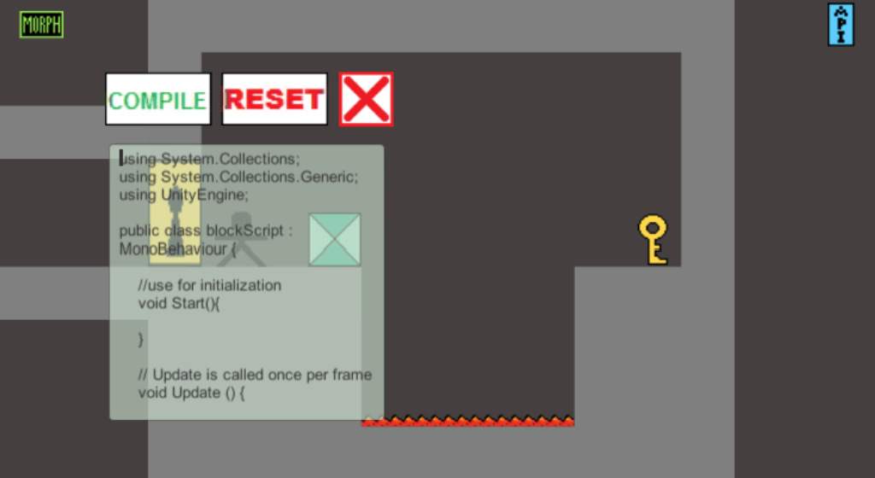
Appendix C : Rapid Prototype GUI Sample - Casey

Slide 66
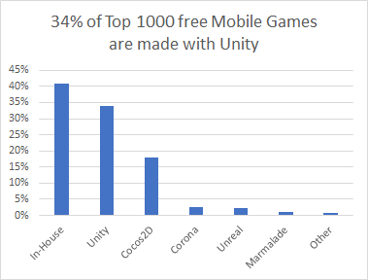
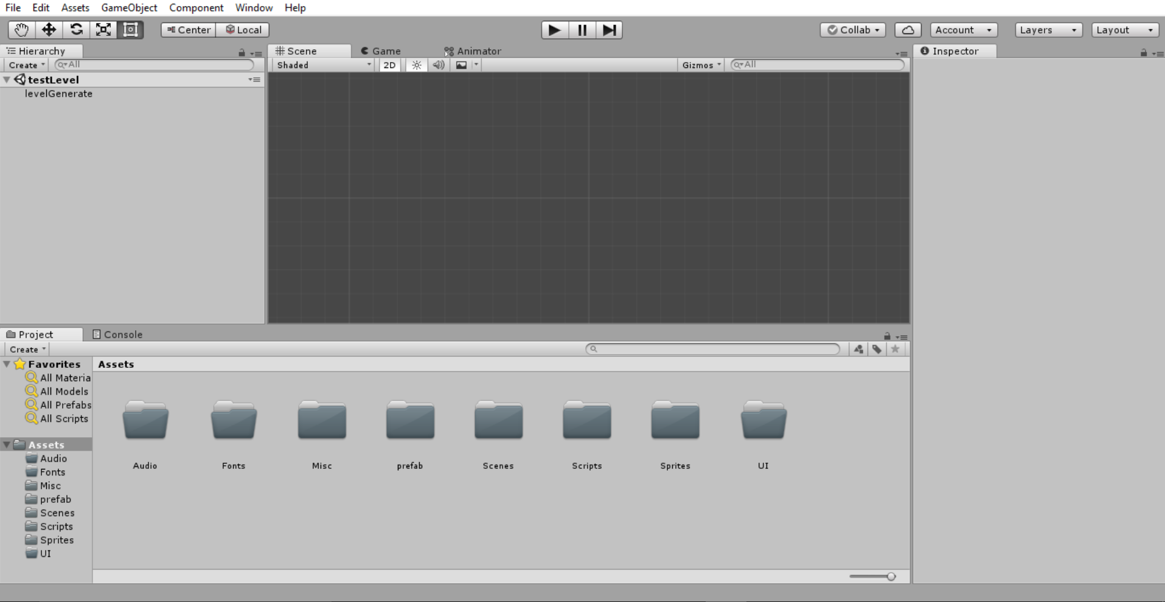
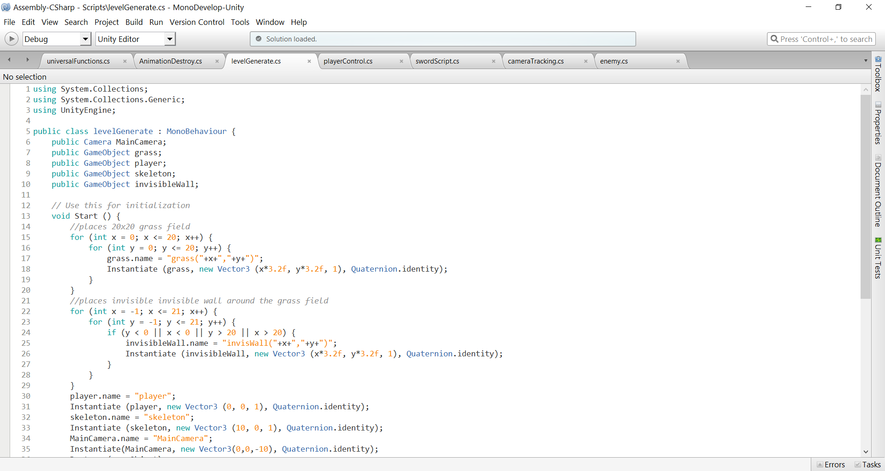
Appendix D : Unity SDK Information
Flexible UI and developer workflow system
Allows users to develop a product efficiently
Tools for software development:
MonoDevelop IDE and support for multiple platforms and build environments
According to Unity Technologies, there were over 5 billion downloads of products made with Unity in quarter one of 2016, with an extra 2.4 billion in mobile product downloads
Image Source: https://unity3d.com/

Slide 67
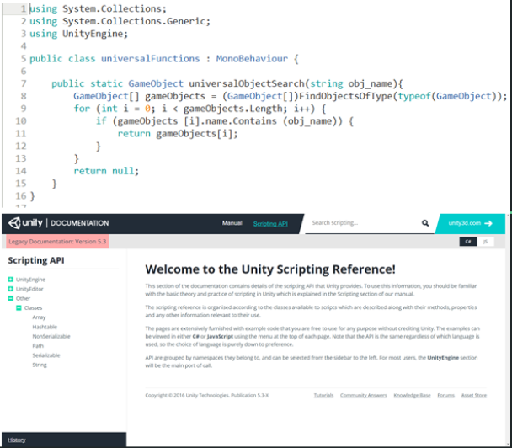
Appendix D : Unity SDK Information
Most flexible and powerful of the Out-of-the-Box programming languages Unity supports
Large suite of built in functions/methods
Unity-specific tools available when used alongside the Engine
Developer support available through Unity’s Scripting API website
Code examples
Complex breakdowns of Unity-specific functionality within C#
Image source: https://docs.unity3d.com/Manual/index.html?_ga=2.37814243.1199564661.1509584726-986472080.1506709735

